Slide 1
Data Structure

Slide 2
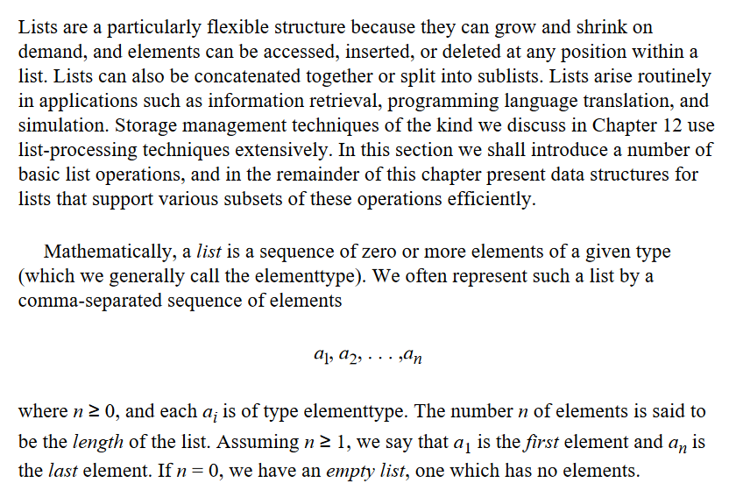

Slide 3
Lists are a particularly flexible structure because they can grow and shrink on demand, and elements can be accessed, inserted, or deleted at any position within a list

Slide 4
Lists can also be concatenated together or split into sub lists.
Lists arise routinely in applications such as information retrieval, programming language translation, and simulation.

Slide 5
Storage management techniques of the kind we discuss in Chapter 12 use list-processing techniques extensively.
In this section, we shall/will introduce a number of basic list operations, and in the remainder of this chapter present data structures for lists that support various subsets of these operations efficiently.

Slide 6
Mathematically, a list is a sequence of zero or more elements of a given type (which we generally call the element type).
Recall:
Comma ,
Colon :
Semi-colon ;
Exclamation point !
Question mark ?

Slide 7
We often represent such a list by a comma-separated sequence of elements
a1, a2, . . . ,an
where n≥ 0, and each «ai» is of type element type.
The number n of elements is said to be the length of the list.
Assuming n≥ 1, we say that «a1» is the first element and «an» is the last element.
If n = 0, we have an empty list, one which has no elements.

Slide 8
A stack is a special kind of list in which all insertions and deletions take place at one end, called the top. Other names for a stack are "pushdown list," and "LIFO" or "last-in-first-out" list. The intuitive model of a stack is a pile of poker chips on a table, books on a floor, or dishes on a shelf, where it is only convenient to remove the top object on the pile or add a new one above the top. An abstract data type in the STACK family often includes the following five operations.
A queue is another special kind of list, where items are inserted at one end (the rear) and deleted at the other end (the front). Another name for a queue is a "FIFO" or "first-in first-out" list. The operations for a queue are analogous to those for a stack, the substantial differences; insertions go at the end of the list, rather than the beginning; and traditional terminology for stacks and queues is different. We shall use the following operations on queues

Slide 9
A stack is a special kind of list in which all insertions and deletions take place at one end, called the top
Other names for a stack are "pushdown list," and "LIFO" or "last-in-first-out" list.

Slide 10
The intuitive model of a stack is a pile of poker chips on a table, books on a floor, or dishes on a shelf, where it is only convenient to remove the top object on the pile or add a new one above the top.
An abstract data type in the STACK family often includes the following five operations…..

Slide 11
A queue is another special kind of list, where items are inserted at one end (the rear) and deleted at the other end (the front).
Another name for a queue is a "FIFO" or "first-in first-out" list.

Slide 12
The operations for a queue are analogous to those for a stack, the substantial differences; insertions go at the end of the list, rather than the beginning; and traditional terminology for stacks and queues is different
We shall use the following operations on queues

Slide 13
One important application of stacks is in the implementation of recursive procedures in programming languages. The run-time organization for a programming language is the set of data structures used to represent the values of the program variables during program execution. Every language that, like Pascal, allows recursive procedures, uses a stack of activation records to record the values for all the variables belonging to each active procedure of a program. When a procedure P is called, a new activation record for P is placed on the stack, regardless of whether there is already another activation record for P on the stack. When P returns, its activation record must be on top of the stack, since P cannot return until all procedures it has called have returned to P

Slide 14
One important application of stacks is in the implementation of recursive procedures in programming languages.
The run-time organization for a programming language is the set of data structures used to represent the values of the program variables during program execution.

Slide 15
Every language that, like Pascal, allows recursive procedures, uses a stack of activation records to record the values for all the variables belonging to each active procedure of a program

Slide 16
When a procedure P is called, a new activation record for P is placed on the stack, regardless of whether there is already another activation record for P on the stack.
When P returns, its activation record must be on top of the stack, (!!)since P cannot return until all procedures it has called have returned to P

